Slide 1
VIIRS Ocean Color Products and Applications
Menghua Wang
& NOAA/STAR Ocean Color Team
NOAA/NESDIS/STAR, E/RA3, 5830 University Research Ct.
College Park, MD 20740, USA
Menghua.Wang@noaa.gov
Second Suomi NPP Applications Workshop
The Westin Huntsville Hotel, Huntsville, Alabama
November 18-20, 2014
Acknowledgements: This work was supported by JPSS/VIIRS funding. We thank MOBY team (PI: Ken Voss) for in situ optics data, VIIRS Cal/Val PIs and their collaborators in support of Cal/Val activities, and NASA/OBPG for MODIS data.

Slide 2
VIIRS Ocean Color Team Members’ Roles & Responsibilities
EDR | Name | Organization | Funding Agency | Task
Lead | Menghua Wang (OC EDR & Cal/Val Lead), L. Jiang, X. Liu, W. Shi, S. Son, L. Tan, X. Wang, P. Naik, J. Sun, K. Mikelsons, V. Lance, M. Ondrusek, E. Stengel | NOAA/NESDIS/ STAR | JPSS/NJO | Leads – Ocean Color EDR Team & Cal/Val Team OC products, algorithms, SDR, EDR, Cal/Val, vicarious cal., refinements, data processing DR- Software updates
Ocean Color | Robert Arnone Sherwin Ladner, Ryan Vandermeulen Adam Lawson, Paul Martinolich, Jen Bowers, Giulietta Fargion | U. Southern MS NRL QinetiQ Corp. SDSU | JPSS/NJO | Coordination Look Up Tables – SDR-EDR impacts, vicarious calibration Satellite matchup tool (SAVANT) – Golden Regions cruise participation WAVE_CIS (AERONET site)
 | Carol Johnson | NIST | JPSS/NJO | Traceability, AERONET Uncertainty
 | Curt Davis, Nicholas Tufillaro | OSU | JPSS/NJO | Ocean color validation, Cruise data matchup West Coast
 | Burt Jones, Matthew Ragan | USC | JPSS/NJO | Eureka (AERONET Site)
 | Sam Ahmed, Alex Gilerson, Soe Hlaing | CUNY | JPSS/NJO | LISCO (AERONET site) Cruise data and matchup
 | Chuanmin Hu | USF | JPSS/NJO | NOAA data continuity
 | Ken Voss & MOBY team | RSMAS –Miami | JPSS/NJO | Marine Optical Buoy (MOBY)
 | Zhongping Lee, Jianwei Wei | UMB | JPSS/NJO | Ocean color IOP data validation and evaluation Ocean color optics matchup
 | Patty Pratt, J. Ip | NGAS | JPSS/NJO | Detector tool Matchup and DR and IDPS updates
Working with: VIIRS SDR team (C. Cao, F. DeLuccia, X. Xiong), DPA/DPE (R. Williamson, Neal Baker), Raytheon (M. Hollingshead), NOAA OC Working Group, NOAA various line-office reps, NASA OBPG (K. Turpie, et al.), NOAA OCPOP, etc.
Collaborators: D. Antoine (BOUSSOLE), B. Holben (NASA-GSFC), G. Zibordi (JRC-Italy), R. Frouin (for PAR), and others.
2
2
Notes:
Top: List STAR (as in SOW) team members here
Bottom: List funded non-STAR (as in SOW) and non-JPSS-funded team members here

Slide 3
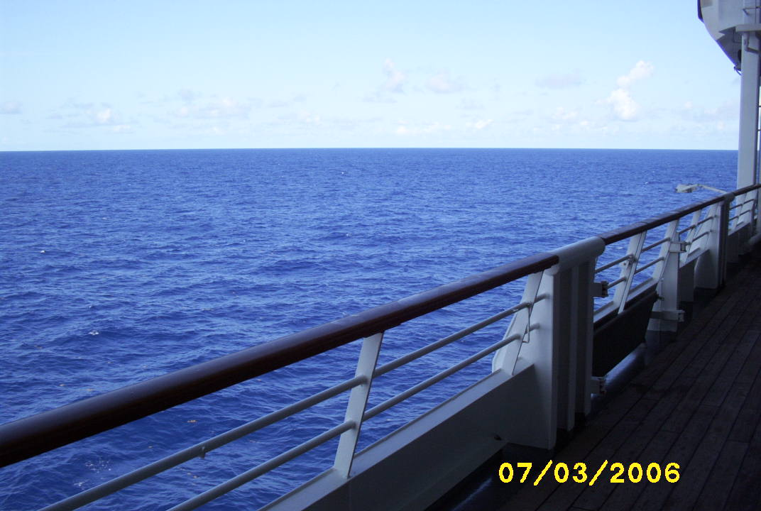
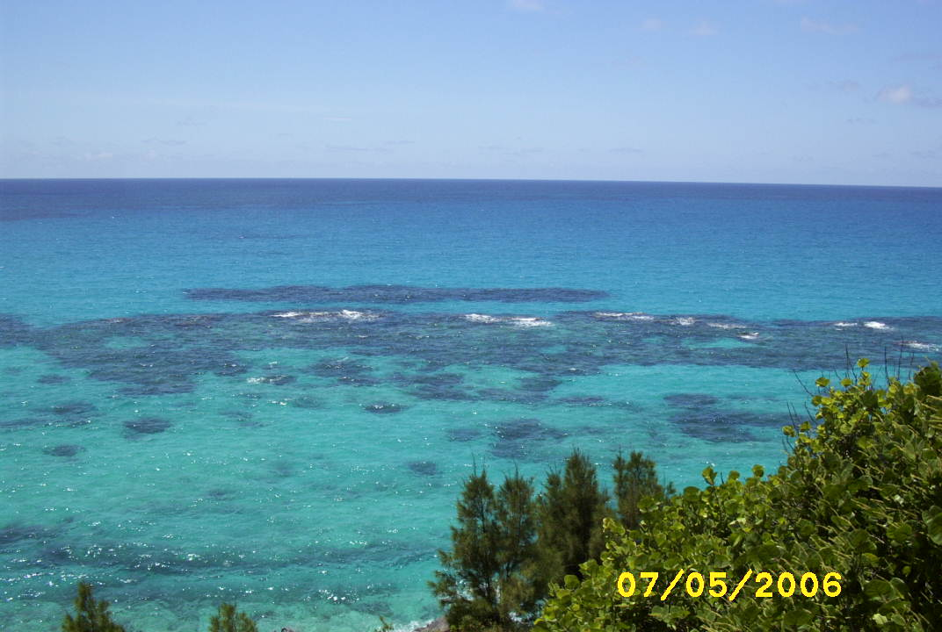
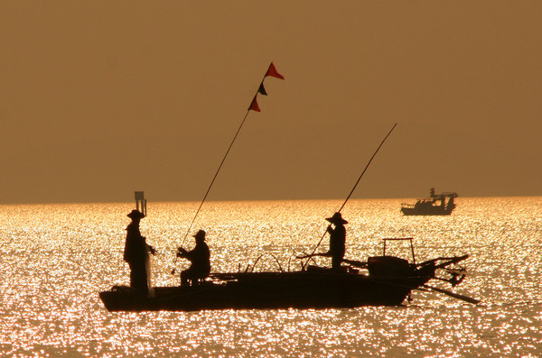
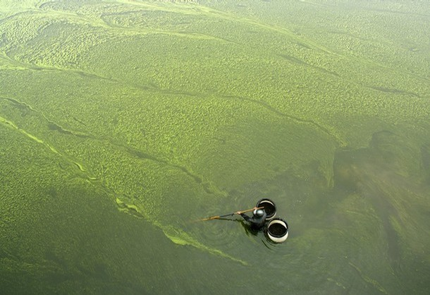
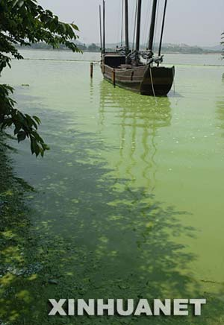
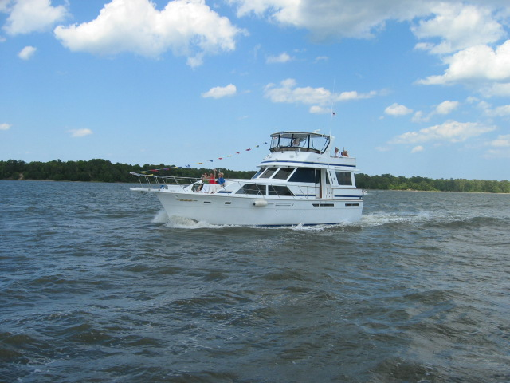
Ocean Color Spectra
Lake Taihu
3
Chesapeake Bay

Slide 4
End-to-End Ocean Color Data Processing
NOAA Ocean Color Team has been developing/building the capability for the End-to-End satellite ocean color data processing including:
Level-0 (or Raw Data Records (RDR)) to Level-1B (or Sensor Data Records (SDR)).
Level-1B (SDR) to ocean color Level-2 (Environmental Data Records (EDR).
Level-2 to global Level-3 (routine daily, 8-day, monthly, and climatology data/images).
Support of in situ data collections for VIIRS Cal/Val activities, e.g., MOBY, AERONET-OC sites, NOAA dedicated cruise, etc.
On-orbit instrument calibration:
J. Sun and M. Wang, “VIIRS solar diffuser calibration and its challenges using solar diffuser stability monitor,” Appl. Opt. (Accepted).
J. Sun and M. Wang, “On-orbit characterization of the VIIRS solar diffuser and solar diffuser screen,” Appl. Opt. (Accepted).
J. Sun and M. Wang, “VIIRS Reflective Solar Bands On-Orbit Calibration and Performance: A Three-Year Update,” Proc. SPIE 9264, Earth Observing Missions and Sensors: Development, Implementation, and Characterization III, October 13-16, 2014.
RDR (Level-0) to SDR (Level-1B) data processing:
Sun, J., M. Wang, L. Tan, and L. Jiang, “An efficient approach for VIIRS RDR to SDR data processing,” IEEE Geosci. Remote Sens. Lett., 11, 2037–2041, 2014.
L. Tan, M. Wang, J. Sun, and L. Jiang, “VIIRS RDR to SDR Data Processing for Ocean Color EDR,” Proc. SPIE 9261, Ocean Remote Sensing and Monitoring from Space, October 13-16, 2014.

Slide 5
VIIRS Spectral Bands for Ocean Color
VIIRS (Visible Infrared Imaging Radiometer Suite) on Suomi NPP
has Ocean and SWIR spectral bands similar to MODIS
VIIRS nominal center wavelength
Spatial resolution for VIIRS M-band: 750 m, I-band: 375 m
5

Slide 6
Satellite-Measured Ocean Color Products
Examples of satellite ocean color products from VIIRS (and MODIS on the satellite Aqua).
Ocean Color Products:
Normalized Water-leaving Radiance nLw(λ) in mW cm⁻² μm⁻¹ sr⁻¹.
Chlorophyll-a Concentration (Chl-a) in mg m⁻³.
Water Diffuse Attenuation Coefficient at 490 nm Kd(490) in m⁻¹, which is related to light penetration and availability in aquatic systems.
Water Diffuse Attenuation Coefficient for Photosynthetically Available Radiation (PAR) Kd(PAR) in m⁻¹.
Inherent Optical Properties (IOPs).
Others, e.g., Total Suspended Sediment (TSS) in mg l⁻¹, water Turbidity in NTU, etc.
Ocean biological and biogeochemical properties, e.g., Chl-a, Kd(490), TSS, Turbidity, etc., are derived from satellite-measured nLw(λ) spectra.
Ocean color data processing:
NOAA Multi-Sensor Level-1 to Level-2 (NOAA-MSL12), which is now NOAA VIIRS official ocean color data processing.
6

Slide 7
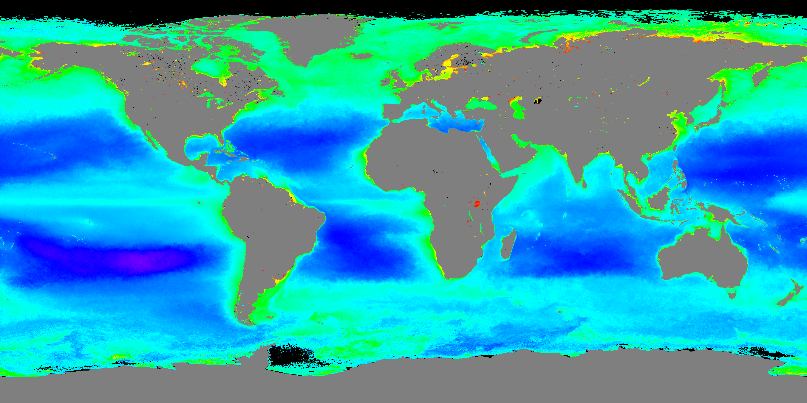
VIIRS Climatology Chlorophyll-a Image (April 2012 to December 2013)
Log scale: 0.01 to 64 mg/m³
Generated using MSL12 for VIIRS ocean color data processing
Wang, M., X. Liu, L. Tan, L. Jiang, S. Son, W. Shi, K. Rausch, and K. Voss, “Impacts of VIIRS SDR performance on ocean color products,” J. Geophys. Res. Atmos., 118, 10,347–10,360, 2013. http://dx.doi.org/10.1002/jgrd.50793

Slide 8
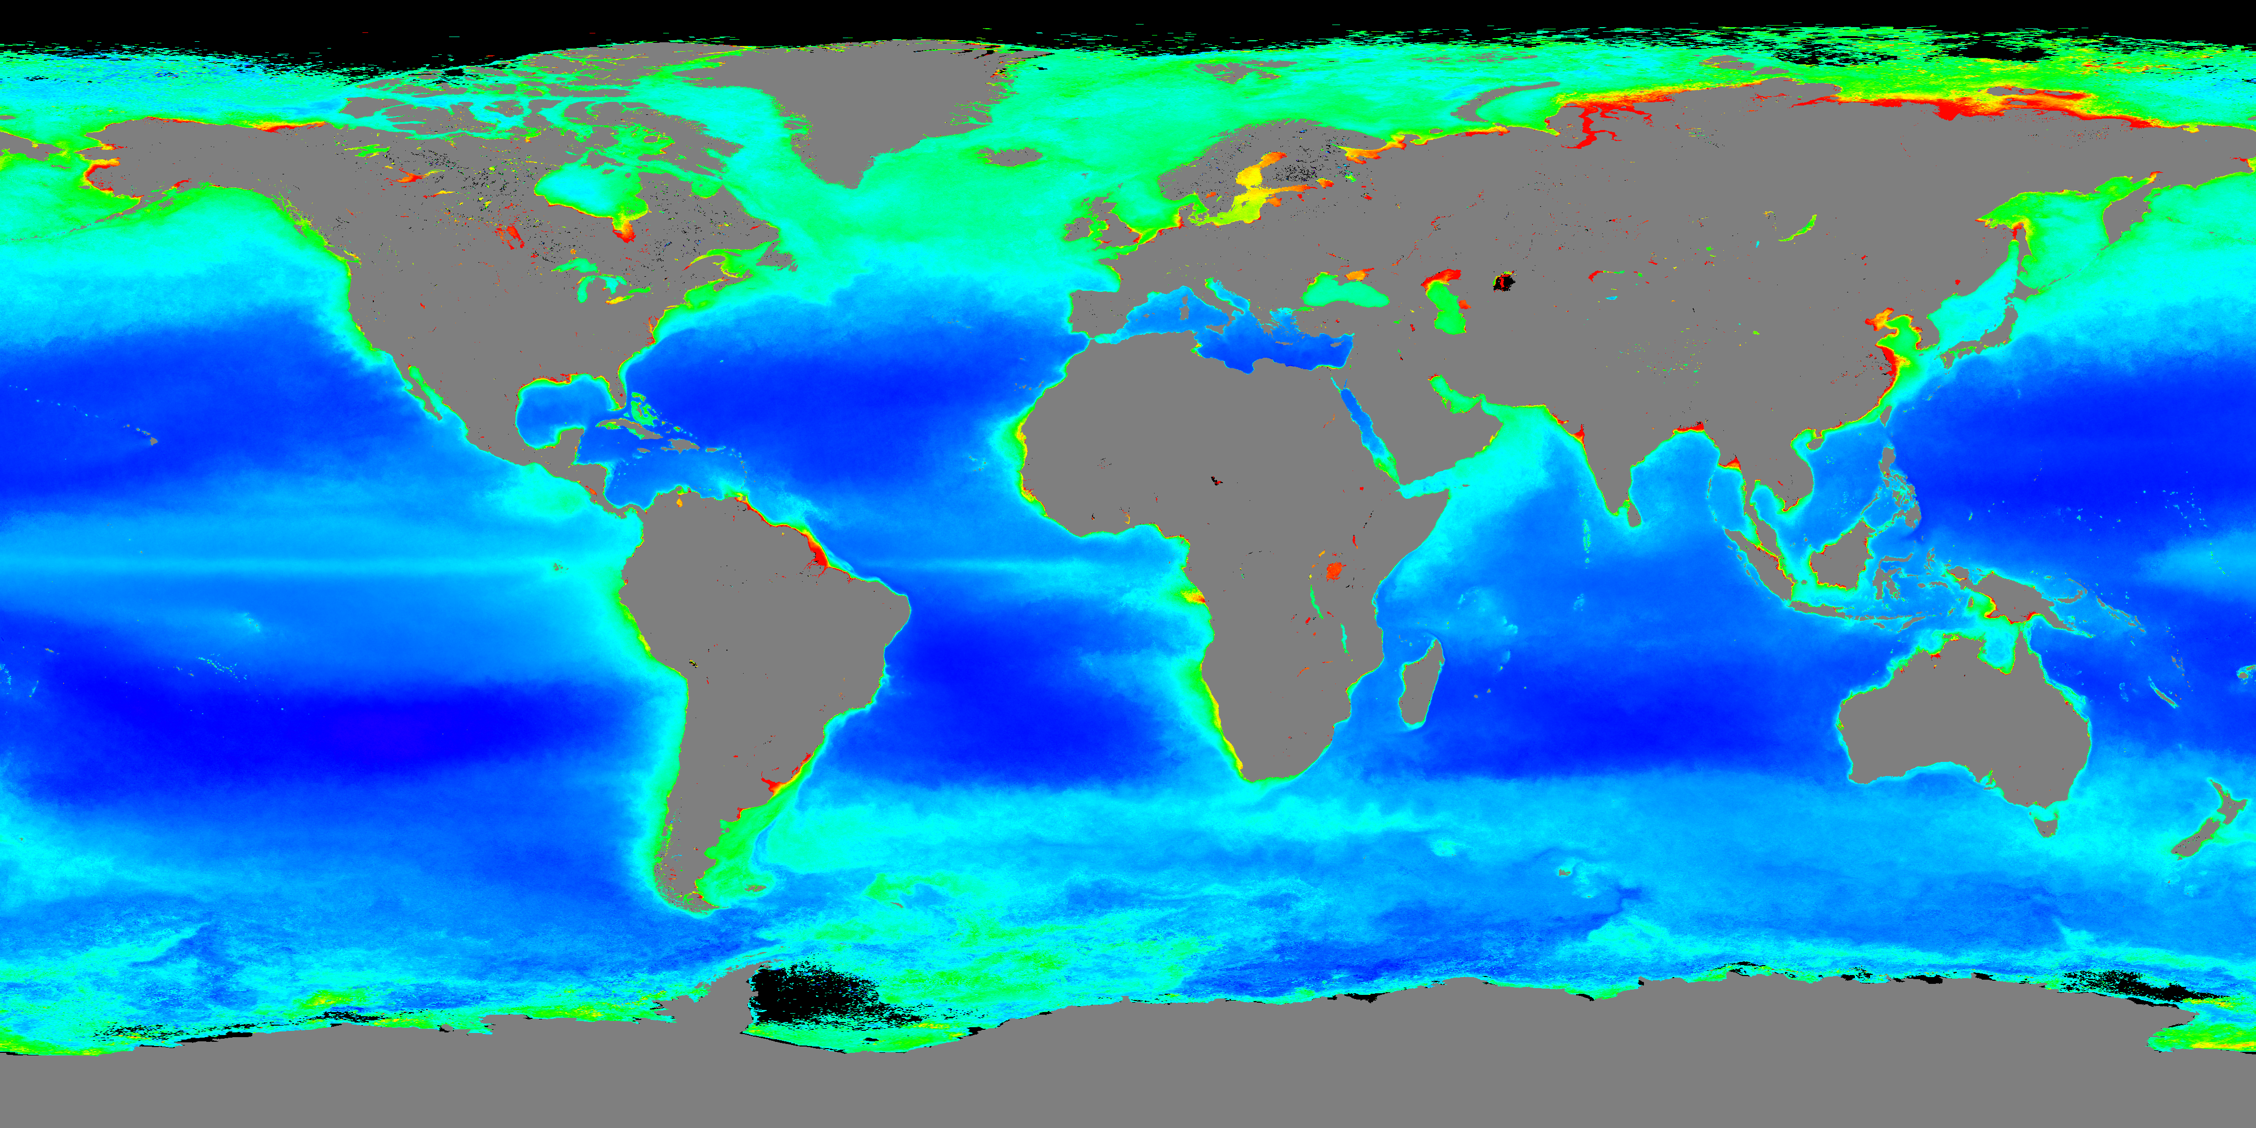
VIIRS Climatology K_{d}(490) Image (April 2012 to December 2013)
Log scale: 0.01 to 64 mg/m³
Log scale: 0.01 to 2 m⁻¹
Generated using MSL12 for VIIRS ocean color data processing

Slide 9
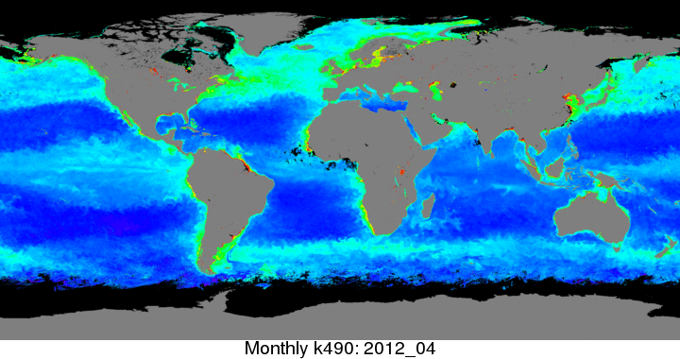
Monthly Composite Image: Animations of VIIRS Global Chl-a and K_{d}(490)

Slide 10
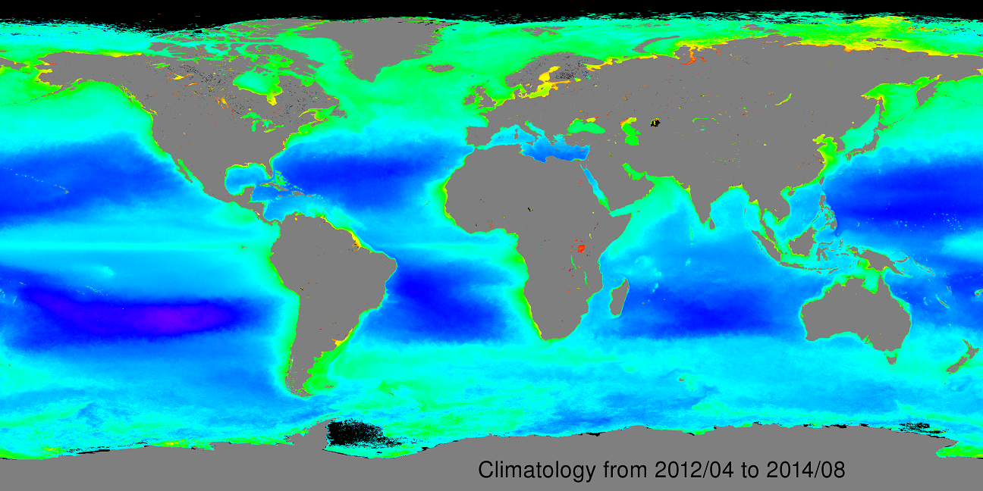
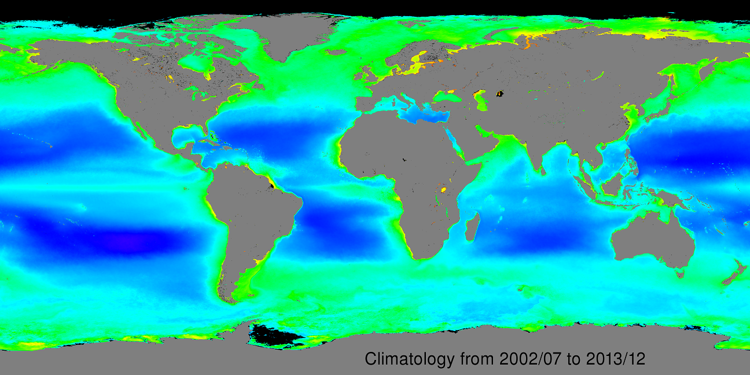
Global Chlorophyll-a Climatology
VIIRS
MODIS

Slide 11
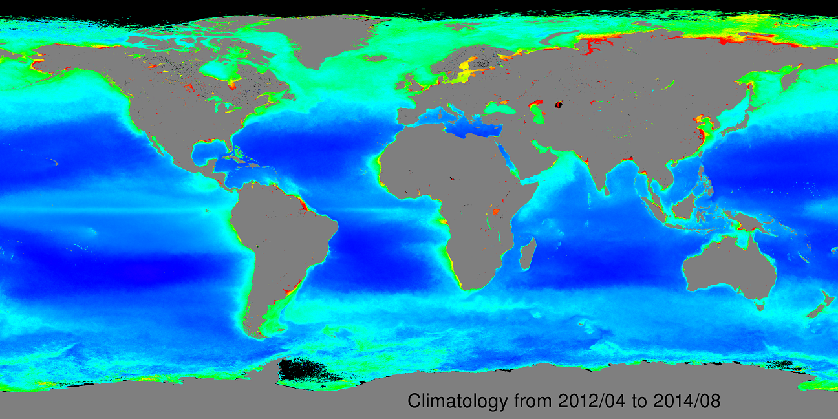
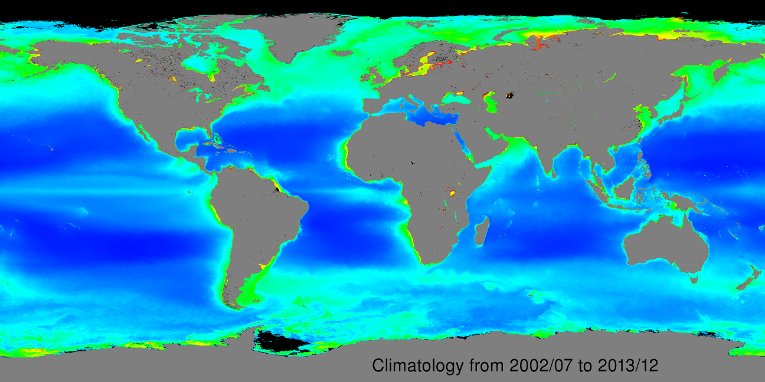
Global K_{d}(490) Climatology
VIIRS
MODIS

Slide 12
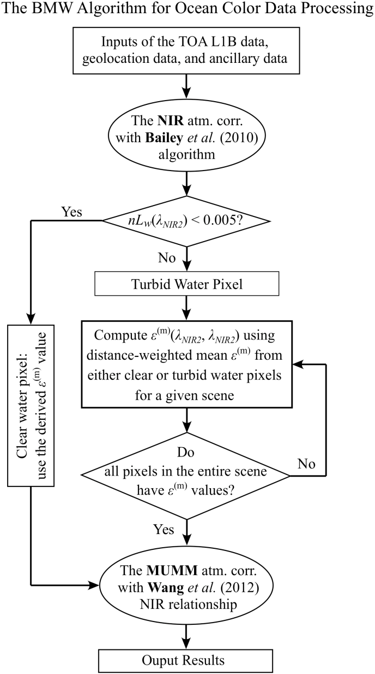
Developed a new NIR ocean reflectance correction algorithm: BMW (Bailey (2010), MUMM (2000), and Wang (2012))
Comparisons of MODIS and VIIRS-derived nL_{w}(λ) images at four selected bands.
Jiang, L. and M. Wang, “Improved near-infrared ocean reflectance correction algorithm for satellite ocean color data processing,” Opt. Express, 22, 21,657–21,678, 2014. http://dx.doi.org/10.1364/OE.22.021657
Notes:
In MODIS results (first two columns), some pixels have a “missing value” (in black color) from the BMW algorithm due to saturation of the NIR 748 nm (or 869 nm) band. It can be confirmed by comparing Fig. 7(n) with Fig. 7(m), where the pixels in black in Fig. 7(n) co-located with the pixels with high values (in red color) in Fig. 7(m). Other than the saturated pixels, BMW results agree reasonably well with the SWIR results, although with a slight overestimation in nL_{w}(λ) at the blue band. It is also noted that at non-saturated locations, nL_{w}(859) is less than ~1.5 mW cm⁻² µm⁻¹ sr⁻¹. In contrast, VIIRS results (two columns in the right) show some discrepancy between those from the BMW and SWIR algorithms. The BMW significantly underestimates nL_{w}(λ) in a region close to the coast north of the sand ridge, which is mostly apparent in Fig. 7(h). In Fig. 7(o), it is shown that VIIRS-derived nL_{w}(862) in this region reach an extremely high value of ~3.0 mW cm⁻² µm⁻¹ sr⁻¹. For such extremely turbid waters with nL_{w}(862) > ~2.0 mW cm⁻² µm⁻¹ sr⁻¹, the NIR nL_{w}(λ) relationship used by the BMW algorithm is no longer valid [27, 33], and the SWIR atmospheric correction should be used instead [33]. In fact, even for the SWIR 1240 nm band, SWIR nL_{w}(λ) can have non-negligible contributions when nL_{w}(862) > ~2.5 mW cm⁻² µm⁻¹ sr⁻¹ [33, 63], in which case the desired band set for the SWIR atmospheric correction is 1640 and 2130 nm (1610 and 2250 nm for VIIRS) [6, 33]. However, the 1640 nm band of MODIS-Aqua has a couple of bad detectors, leaving the 1240 and 2130 nm bands as the usual choice for MODIS-Aqua SWIR atmospheric correction. For the VIIRS SWIR approach, VIIRS SWIR 1238 and 1610 nm bands are used because there are still some calibration issues for the VIIRS SWIR 2250 nm band. Still, from Fig. 7 it is found that VIIRS SWIR results are much smoother and more realistic than the BMW results. We have also checked the aerosol optical thickness and found that the SWIR method gives smooth and realistic results in the extremely turbid region (not shown here) where BMW fails.

Slide 13
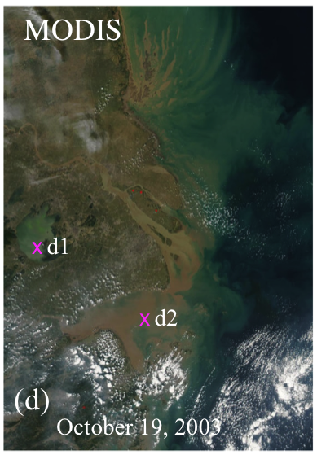
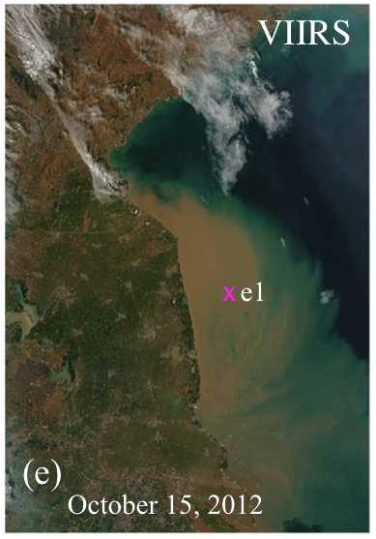
Compare BMW with Other Algorithms (Implemented in MSL12)
Comparisons of MODIS (a,b) and VIIRS-derived (c) nL_{w}(λ) spectra as a function of wavelength for the four atmospheric correction algorithms, and (d) scatter plot of VIIRS-derived nL_{w}(λ) at various wavelengths from the BMW against SWIR, randomly sampled from the entire VIIRS granule corresponding to the coverage plot (e).

Slide 14
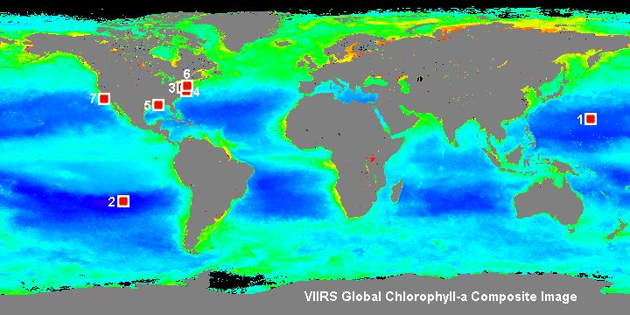
VIIRS Ocean Color EDR Monitoring Sites
1. MOBY Site; 2. South Pacific Gyre; 3. Chesapeake Bay; 4. US East Coast; 5. AERONET-OC CSI Site; 6. AERONET-OC LISCO Site; 7. AERONET-OC USC Site.
Website:
http://www.star.nesdis.noaa.gov/sod/mecb/color/
14

Slide 15
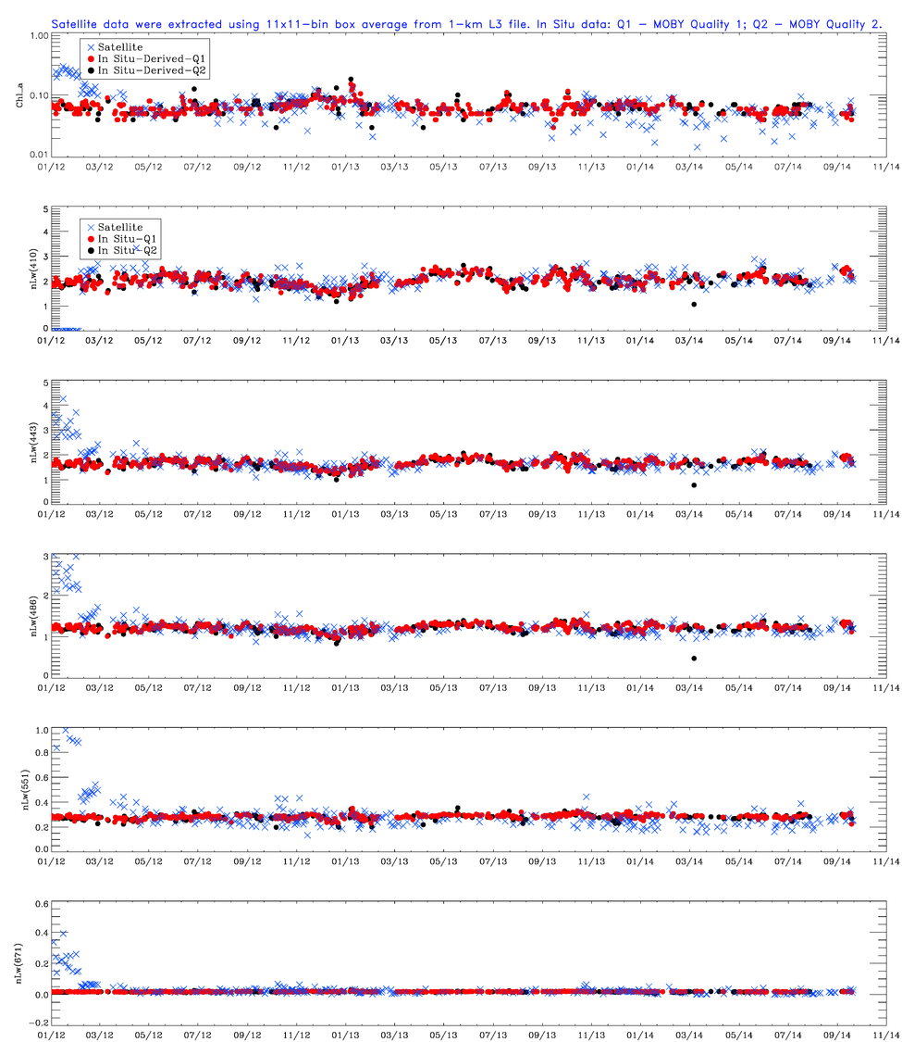
MOBY Data
Comparison of VIIRS NOAA-MSL12 results with MOBY in situ data.
Note:
Vicarious calibration gains applied since May 2012.
Gains derived using MOBY data.
Bad calibration
Satellite data in blue and MOBY data in red

Slide 16
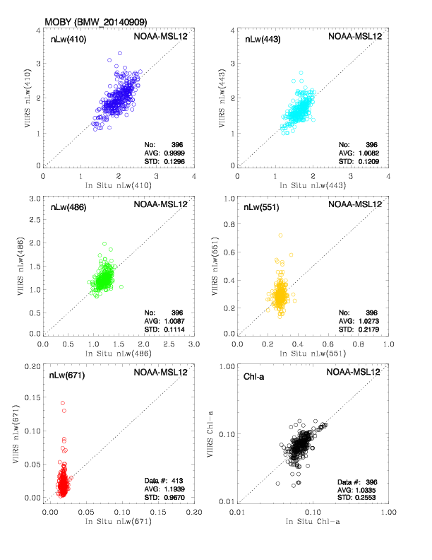
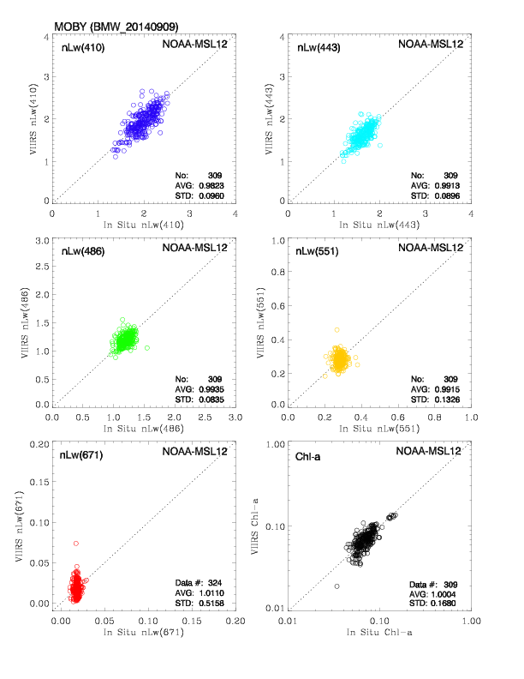
VIIRS–MOBY In Situ Matchups
Reduced matchup noise with new straylight flag (Jiang & Wang 2013)
Matchup with No Straylight Flag Applied
Matchup with Straylight Flag Applied

Slide 17
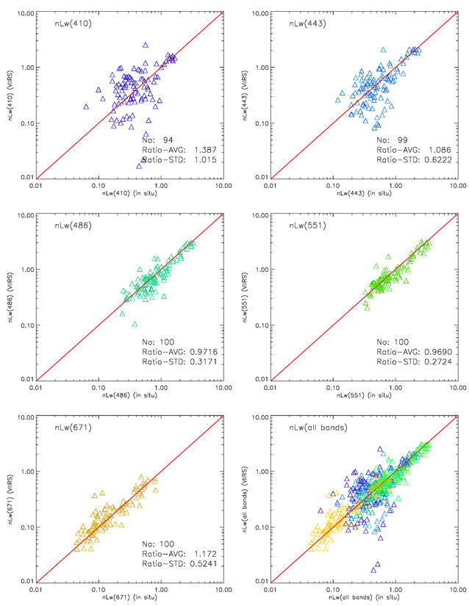
AERONET-OC CSI Site nL_{w} scatter plot Gulf of Mexico

Slide 18
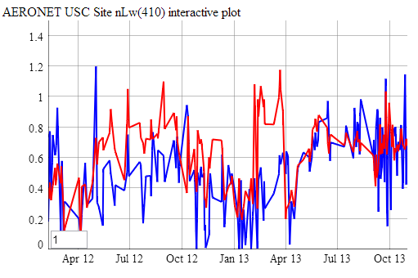
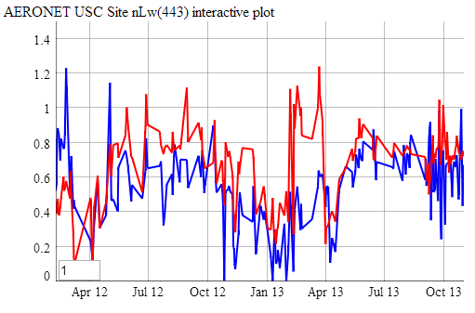
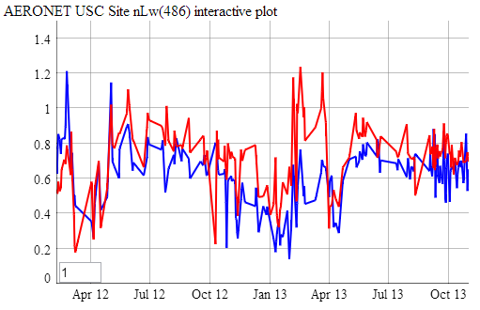
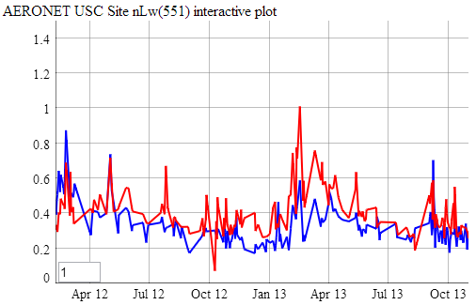
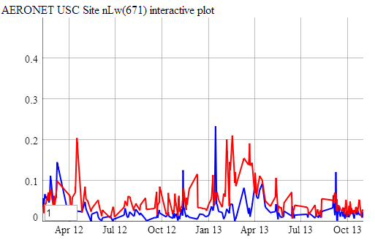
AERONET-OC (USC) nL_{w} Time Series
In Situ
VIIRS (NOAA-MSL12)

Slide 19
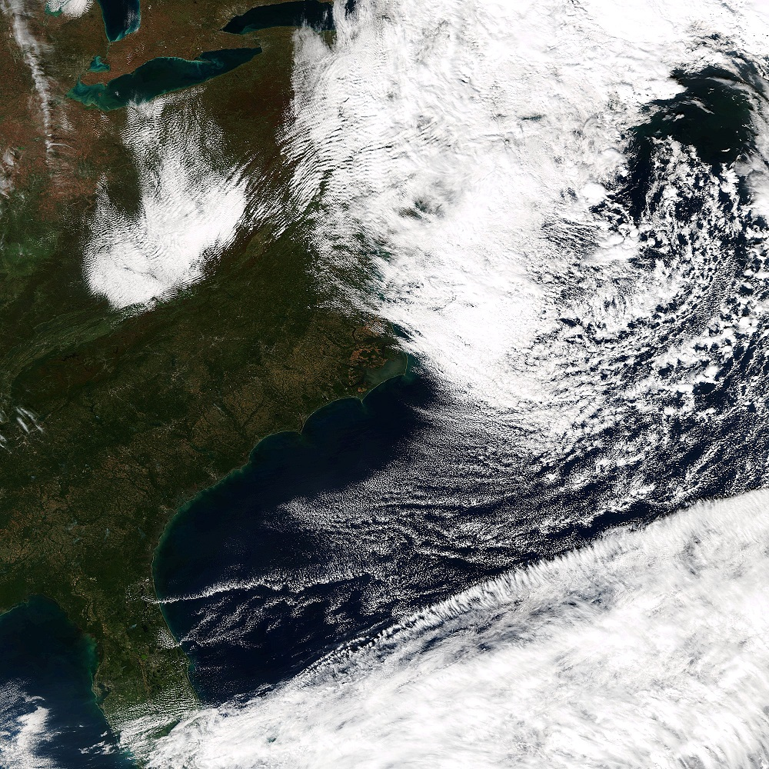
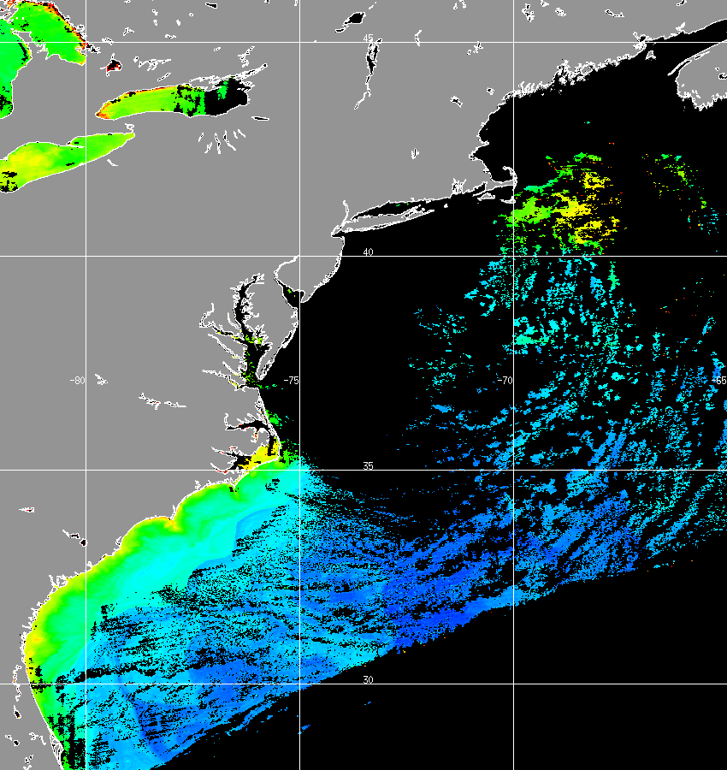
Data Monitoring: US East Coast, Oct. 23, 2014
(Routine Daily Images from Various Coastal Sites)
VIIRS True Color Image
VIIRS Chlorophyll-a

Slide 20
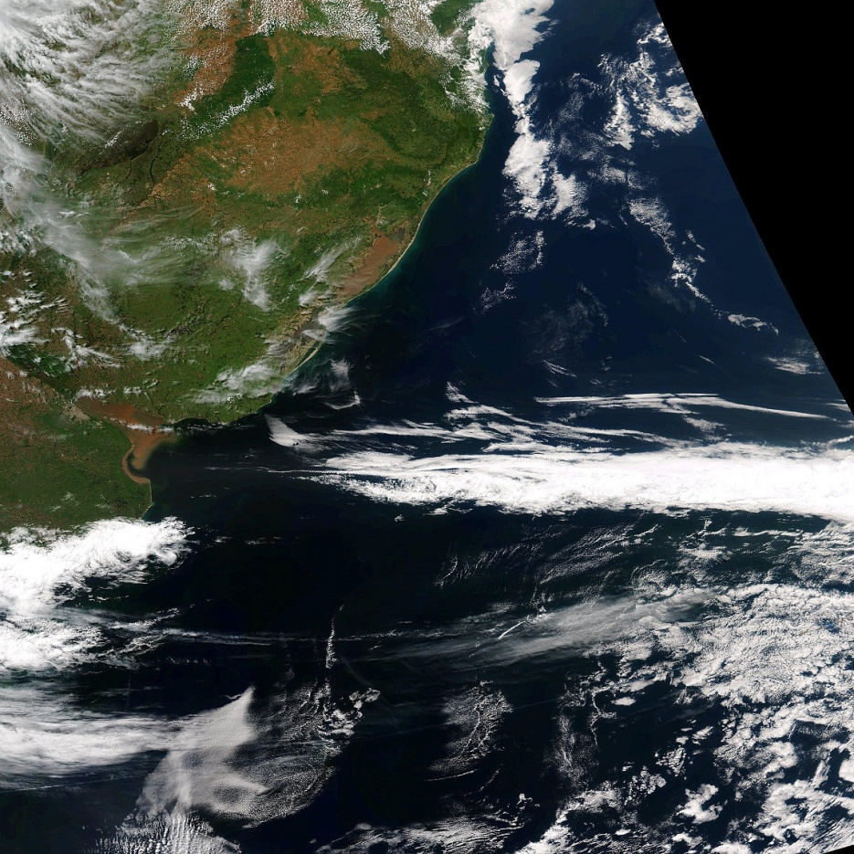
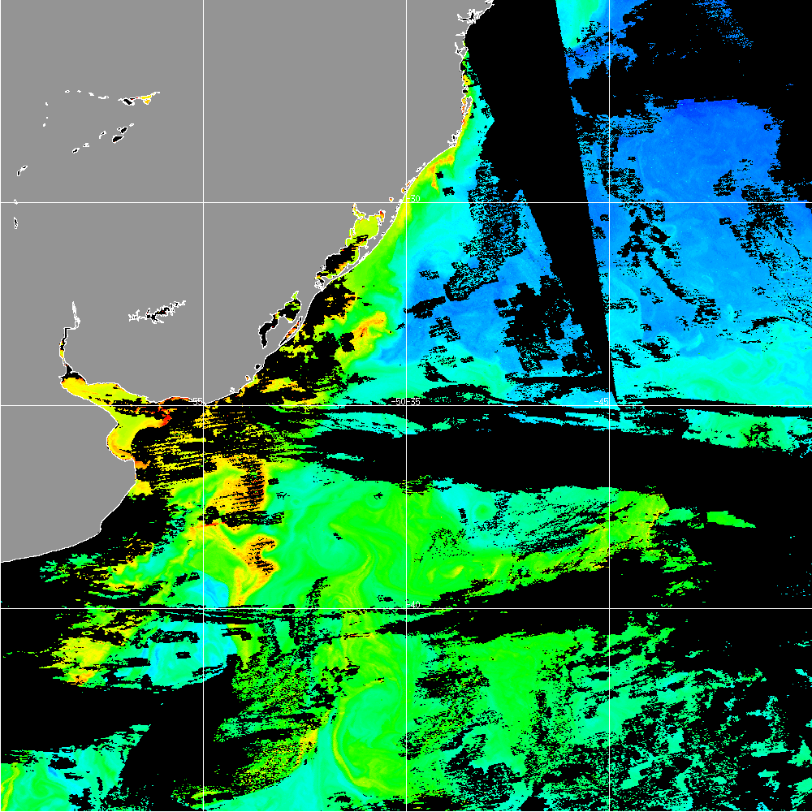
Data Monitoring: La Plata River, Oct. 23, 2014
(Routine Daily Images from Various Coastal Sites)
VIIRS True Color Image
VIIRS Chlorophyll-a

Slide 21
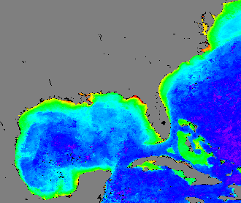
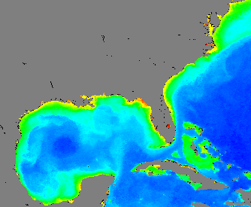
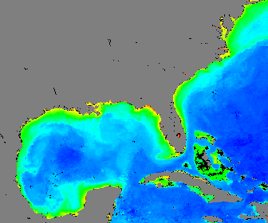
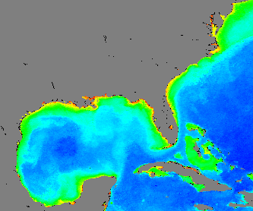
Performance in Coastal and Inland Waters (1)
(US East Coast—October 2013 Monthly)
IDPS
MSL12-NIR
MODIS-NASA/OBPG
MSL12-SWIR

Slide 22
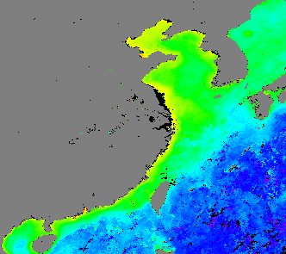
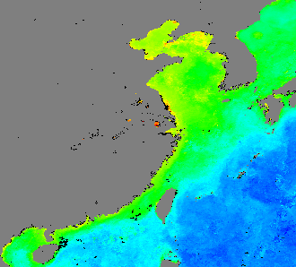
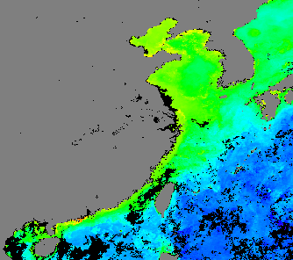
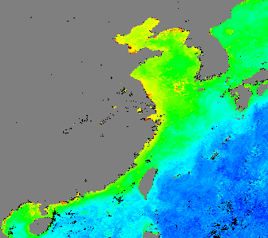
Performance in Coastal and Inland Waters (2)
(China East Coast—October 2013 Monthly)
IDPS
MSL12-NIR
MODIS-NASA/
OBPG
MSL12-SWIR

Slide 23
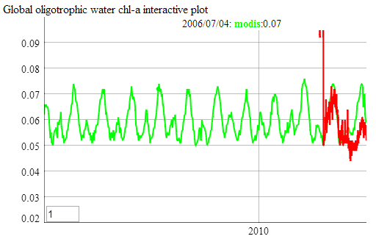
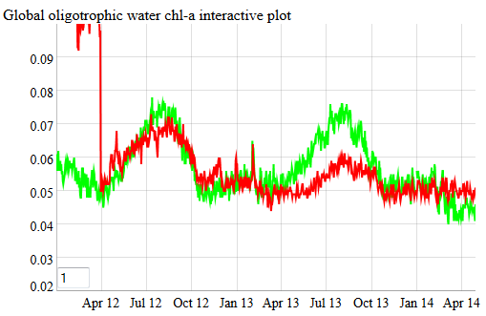
The Existing VIIRS Calibration Issue
MODIS-Aqua global oligotrophic
water Chl-a from 2002 to 2013
(green), overplotted with VIIRS data
from 2012 to 2013 (red)
MODIS-Aqua
VIIRS (NOAA-MSL12)
VIIRS and MODIS-Aqua match each other quite well in 2012.
They have noticeable difference in 2013 (biased low from VIIRS).
Since MODIS-Aqua has a reasonable Chl-a annual repeatability, It is confirmed that VIIRS SDR has calibration issues, in particular, for the M4 (551 nm) band (biased low), at least for 2013.

Slide 24
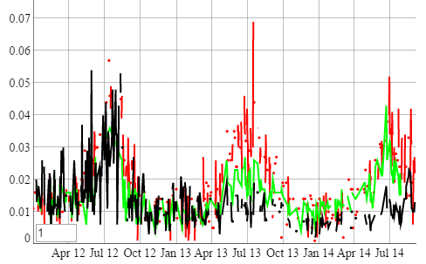
VIIRS New Calibration Results
Comparison of Chl-a based on new calibrated SDR (green line) and IDPS SDR (black line) with MODIS-derived Chl-a (red line) in the South Pacific gyre. Chl-a results from new calibrations are significantly improved.

Slide 25
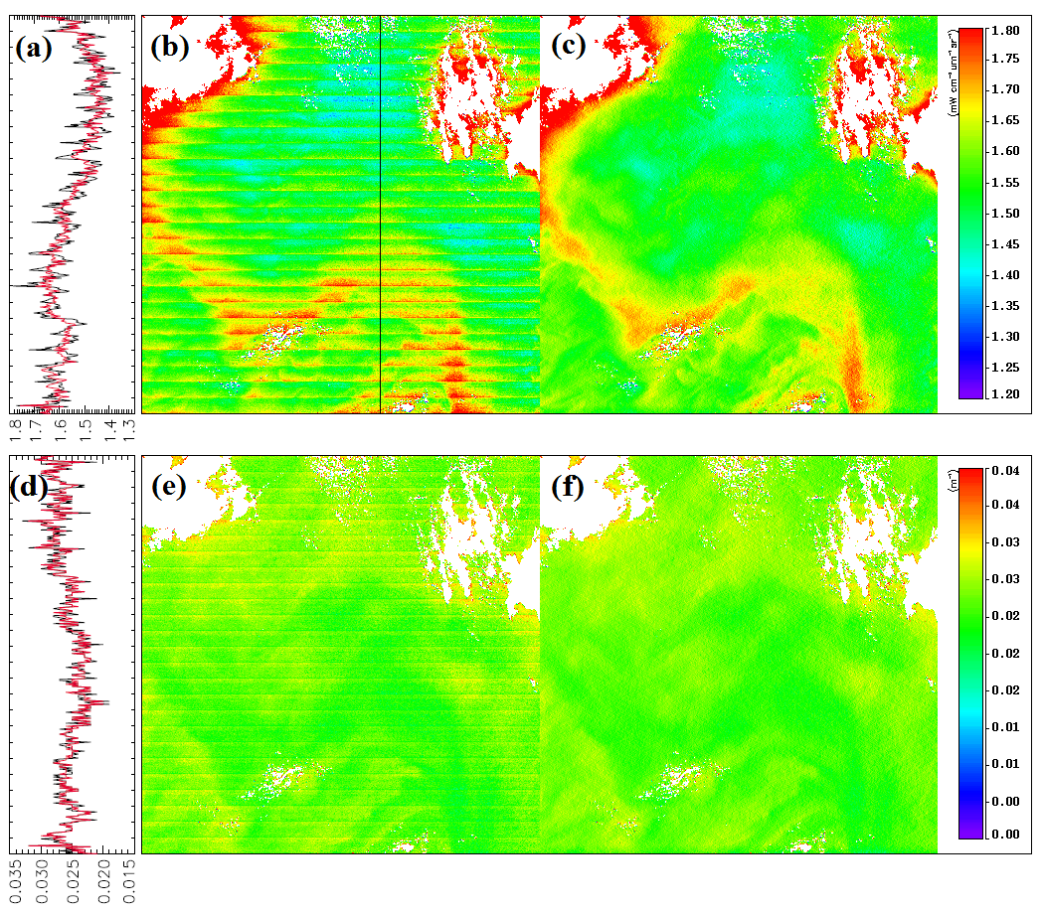
Destriping of VIIRS Ocean Color Products
(Examples)
nL_{w}(412)
K_{d}(490)
Mikelsons, K., M. Wang, L. Jiang, and M. Bouali, “Destriping algorithm for improved satellite-derived ocean color product imagery,” Opt. Express, 22, 28058-28070, 2014. http://dx.doi.org/10.1364/OE.22.028058
Notes:
Destriping of ocean color products nL_{w}(412) (upper panels: a–c) and diffuse attenuation coefficient K_{d}(490) (lower panels: d–f) obtained from VIIRS-SNPP on April 19, 2014 at around 21:20 UTC near (13°S, 114°W). The original data are shown in panels (b) and (e), while the destriped data are shown in panels (c) and (f). The values along the black line in panel (b) are plotted in panels (a) and (d) with black lines from original images (panels (b) and (e)) and red lines from destriped images (panels (c) and (f)).

Slide 26
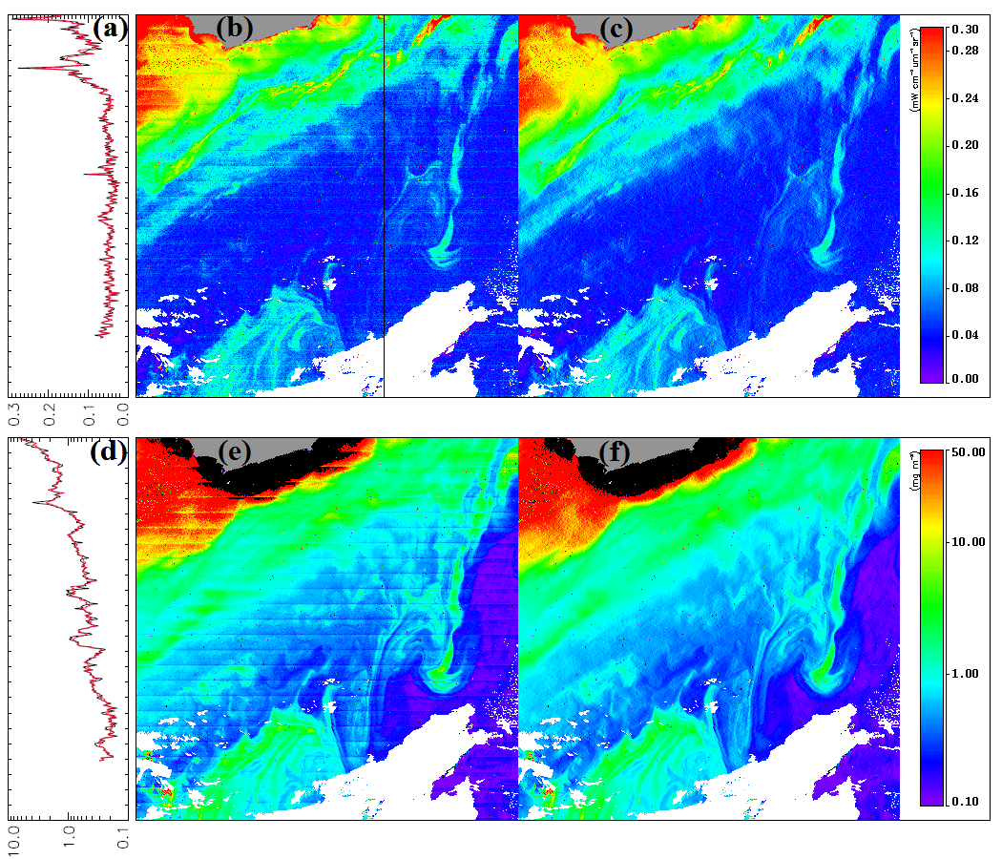
Destriping of VIIRS Ocean Color Products (Examples)
nL_{w}(671)
Chlorophyll-a
Notes:
Destriping of ocean color products nL_{w}(671) (upper panels: a–c) and chlorophyll-a concentration (lower panels: d–f) obtained by VIIRS-SNPP on July 16, 2013 at around 17:38 UTC near (36°S, 55°W). The original data are shown in panels (b) and (e), while the destriped data are shown in panels (c) and (f). The values along the black line in panel (b) are plotted in panels (a) and (d) with black lines from original images (panels (b) and (e)) and red lines from destriped images (panels (c) and (f)).

Slide 27
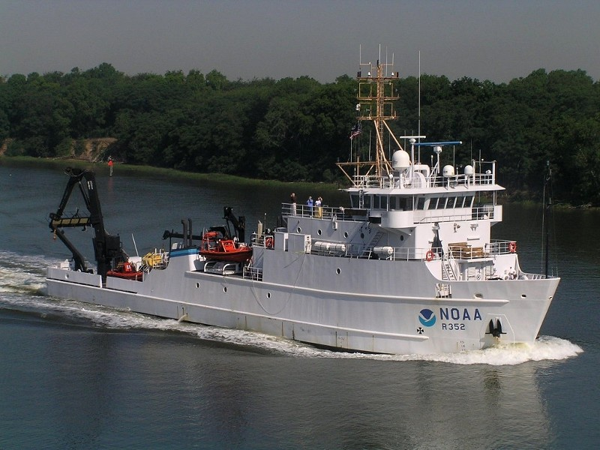
VIIRS Dedicated Cal/Val Cruise NOAA Ship Nancy Foster November 11-21, 2014
International and Interagency Collaboration:
US, EC, NOAA, NASA, NRL, JRC, Academics
Planned Instruments/Observations
Underway Sampling Systems | Profiling Systems | Surface Station Systems | Water Sample Analyses
2x AC9 or ACS | Hyperpro | Microtops | HPLC
Temp, sal, fluorometer | MicroPRO (multispectral with Lu, Ed, Eu) | Spectrix | Carbon, POC, DOC
Surface PAR, winds speed and direction, | C-ops (multispectral 18-19? wavelengths) | ASD | Filter pad Absorption
ADCP (ship) | Optics package 1- ACS, AC9, 9 wavelength backscatter on 1 angle; 9 angle (60 to 170 deg) at 532nm, battery powered, rated to 500m. | GER | Chl Fluorometric extracted - Turner on board
Spectral bb | Optics Package 2 - CTD - bbFL7, ac-s; 200m power cable; need winch; should have room to add a PAR sensor | HTSRB - HIS_ nLw - ED | FRRF, ALF
HYPERSAS_POL - Surface looking | two temperature; two conductivity; two DO; pH; Seapoint SCF (chlorophyll); Seapoint turbidity | SBA- Lw and Ed(0+) | Flowcam
ALF-A (Advanced Laser Flurometry) | FRRF (add to a package - independent data and power) (Max 150m) | NURADS
bbe |  | SURF Surf Upwell Rad, Fiber
mini-FIRe,--> e photophysiology |  | TRIOS (hyperspectral, 3 and 7 degrees FAFOV)
Flowcam |  | HYPERSAS_POL - Surface looking (HyperSAS)
TRIOS
Notes:
International (JRC)
and Interagency (NASA, JRC, NRL, NOAA)

Slide 28
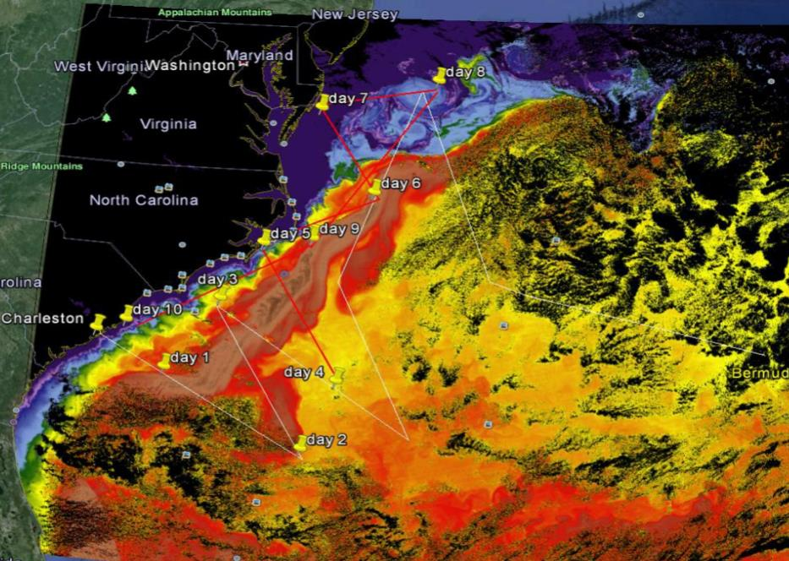
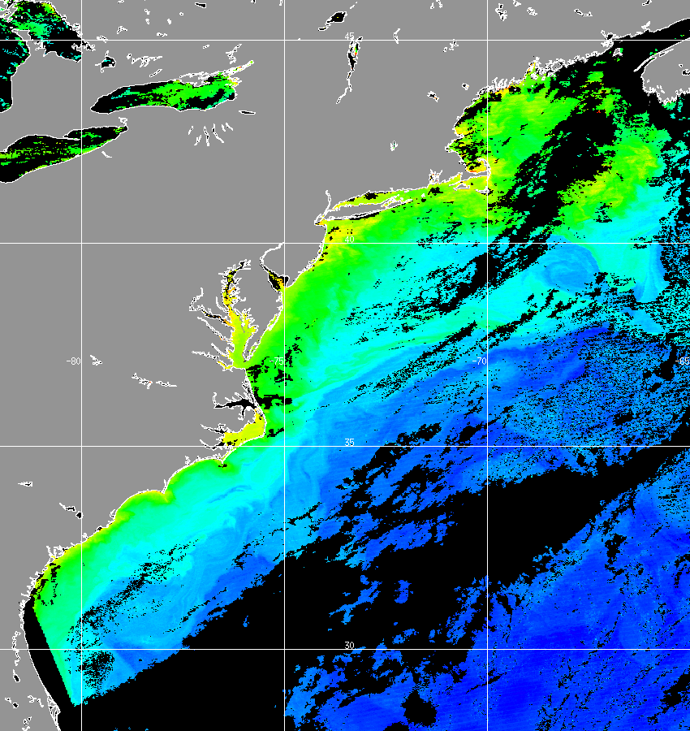
Example of Cruise Track
X
Across Gulf Stream - SST
Image: VIIRS SST Dec. 2013 and tentative cruise track overlaid onto Google Ocean
Across Coastal Fronts into Blue Water
Image: VIIRS MSL12 Chl-a Oct. 8, 2014
NOAA Ocean Color EDR Team
Objectives:
JPSS VIIRS ocean color satellite product validation,
Inter-calibration inter-comparison of validation techniques and measurements, and
Optical characterization of ocean variability, i.e., coastal, near-shore, cross-shelf, eddies, fronts, filaments, blue water, etc.
Image: VIIRS NOAA MSL12 chlorophyll 8 Oct 2014
courtesy NOAA Ocean Color EDR Team

Slide 29
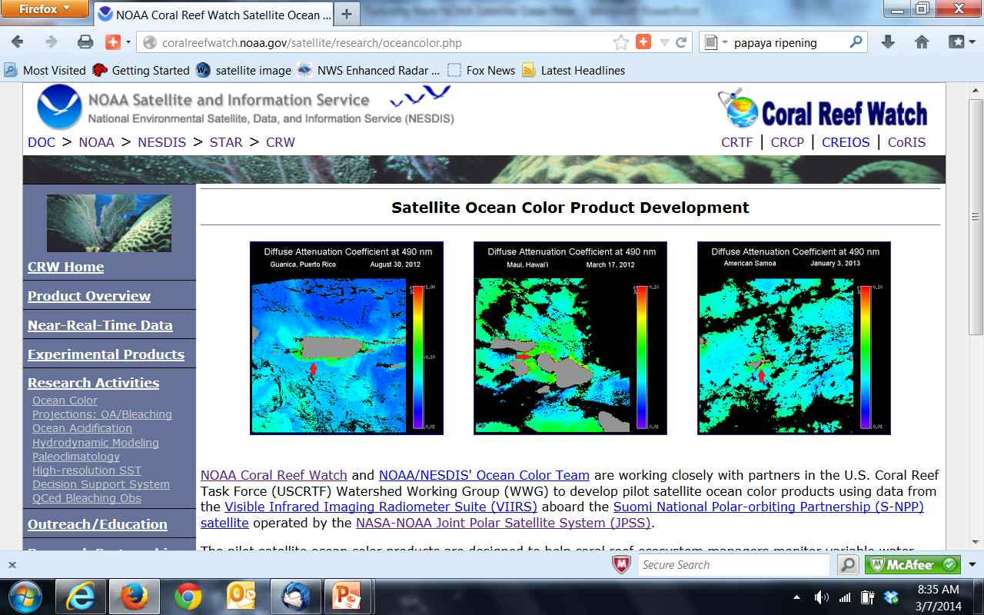
http://coralreefwatch.noaa.gov/satellite/research/oceancolor.php
Ocean Color Tools for Reef Managers
From Coral Reef Watch

Slide 30
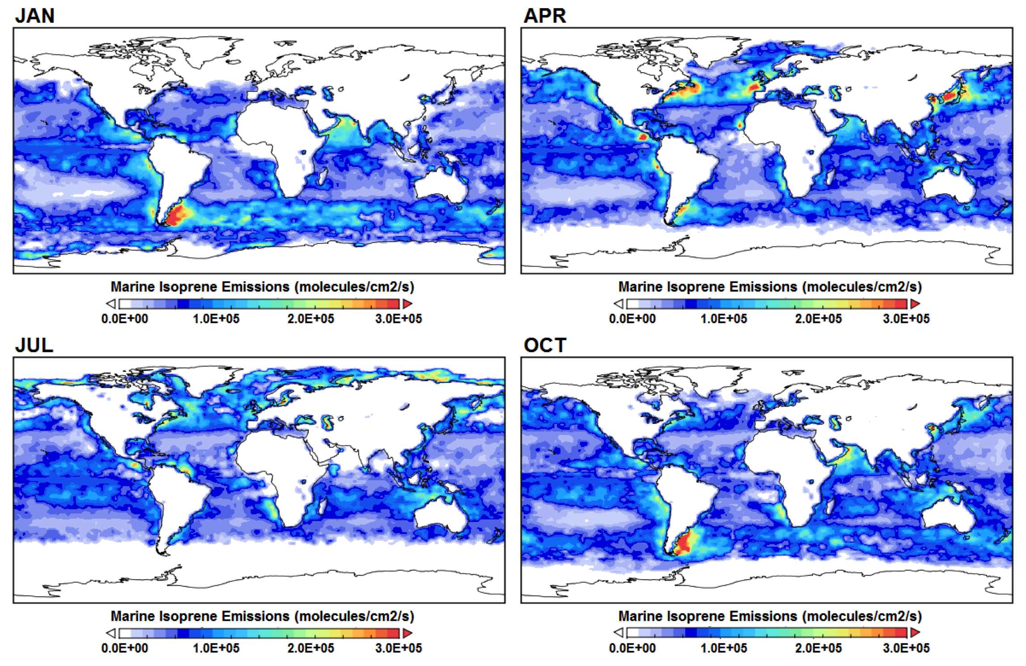
Global Distribution of Marine Isoprene Emission
Tong et al. (JPSS Proving Ground Project)
Inputs: Chl-a, K_{d}(490), PAR

Slide 31
Conclusions
VIIRS ocean color products have been improved after the implementation of some important updates, new algorithms, and with vicarious calibrations.
In general, VIIRS OC normalize water-leaving radiance spectra show reasonable agreements with in situ measurements at MOBY, AERONET-OC sites, and various other ocean regions.
The new NIR ocean reflectance correction algorithm (BMW) improves ocean color data over coastal and inland waters using the NIR-based atmospheric correction.
In global deep waters and oligotrophic waters, the VIIRS ocean color products generated from MSL12 were consistent with MODIS-Aqua in 2012, but discrepancy started to become noticeable for VIIRS Chl-a data since early 2013. We confirmed that this is due to VIIRS calibration problem in 2013.
We developed VIIRS instrument calibration capability, and with new calibration LUTs, VIIRS ocean color data are significantly improved compared with those from MODIS-Aqua over global open oceans.
Although there are still some issues, our evaluation results show that VIIRS-SNPP is capable of providing high-quality global ocean color products in support of science research and operational applications.
We have been actively working with other current and future ocean color sensors, e.g., MODIS-Aqua, Korean GOCI, EUMETSAT for Sentinel-3 (launch 2015), JAXA GCOM-C (launch early 2017), and VIIRS on J1 (launch 2017).
Website:
http://www.star.nesdis.noaa.gov/sod/mecb/color/

Slide 32
Thank You!

